Slide 1
Energy communities and collective activities
Aiming for a future proof integration
Lessons learned from the regulatory sandbox Thor Park

Slide 2


Thor Park – Regulatory sandbox
Thermal networks (part of multi- energy)
DC (micro-) grids
Energy communities New market organization models
€

Slide 3
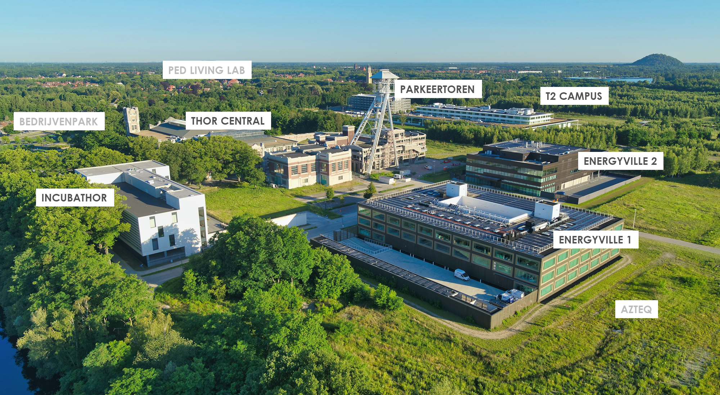

Slide 4
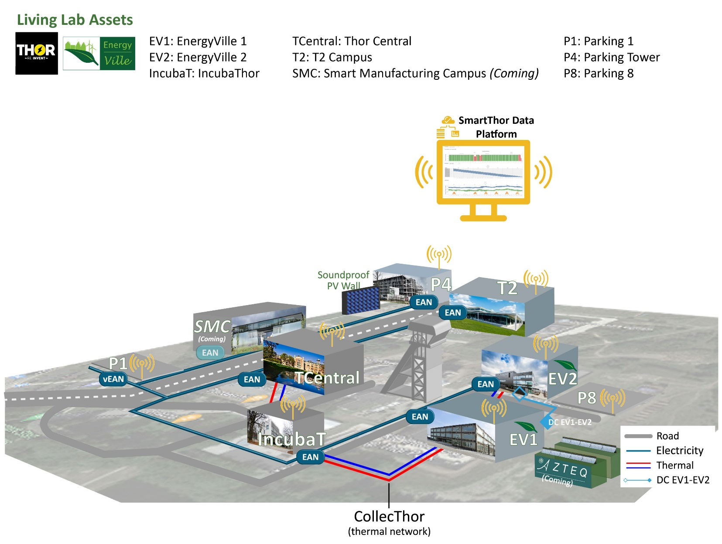

CollecThor® Thermal network
Thor Park
Parking Tower
EV charging 10 connections (5 x dual 22kW)
PV 54 kWp (extension?)
T2 Campus
PV 158 kWp
EnergyVille 2
EV charging 10 connections (5 x dual 22kW)
PV 67kWp
Smart Manufacturing Campus (planned)
PV investigated
P4
T2
EV2
SMC
EAN
EAN
EAN
Parking 8
EV charging 2 x 11kW
TCentral
EAN
EV1
EAN
EAN
IncubaT
EAN
EnergyVille 1
EV charging 520 kW over 27 sockets
(5 x 3,7kW, 2 x 7,4kW, 18 x 22kW, 1 x 43kW, 1 x 50kW DC)
Electric pool vehicles (V2G ready)
PV 369 kWp (South-Nord, East-West)
vEAN
Parking 1
EV charging 6 x 11kW
Thor Central
IncubaThor
EV charging is being investigated
PV is being investigated
1200 kW cooling
Ventilation
HP cooling 150kW / heating 180kW
Gas heating (back-up + high temperature)
418 kW cooling

Slide 5

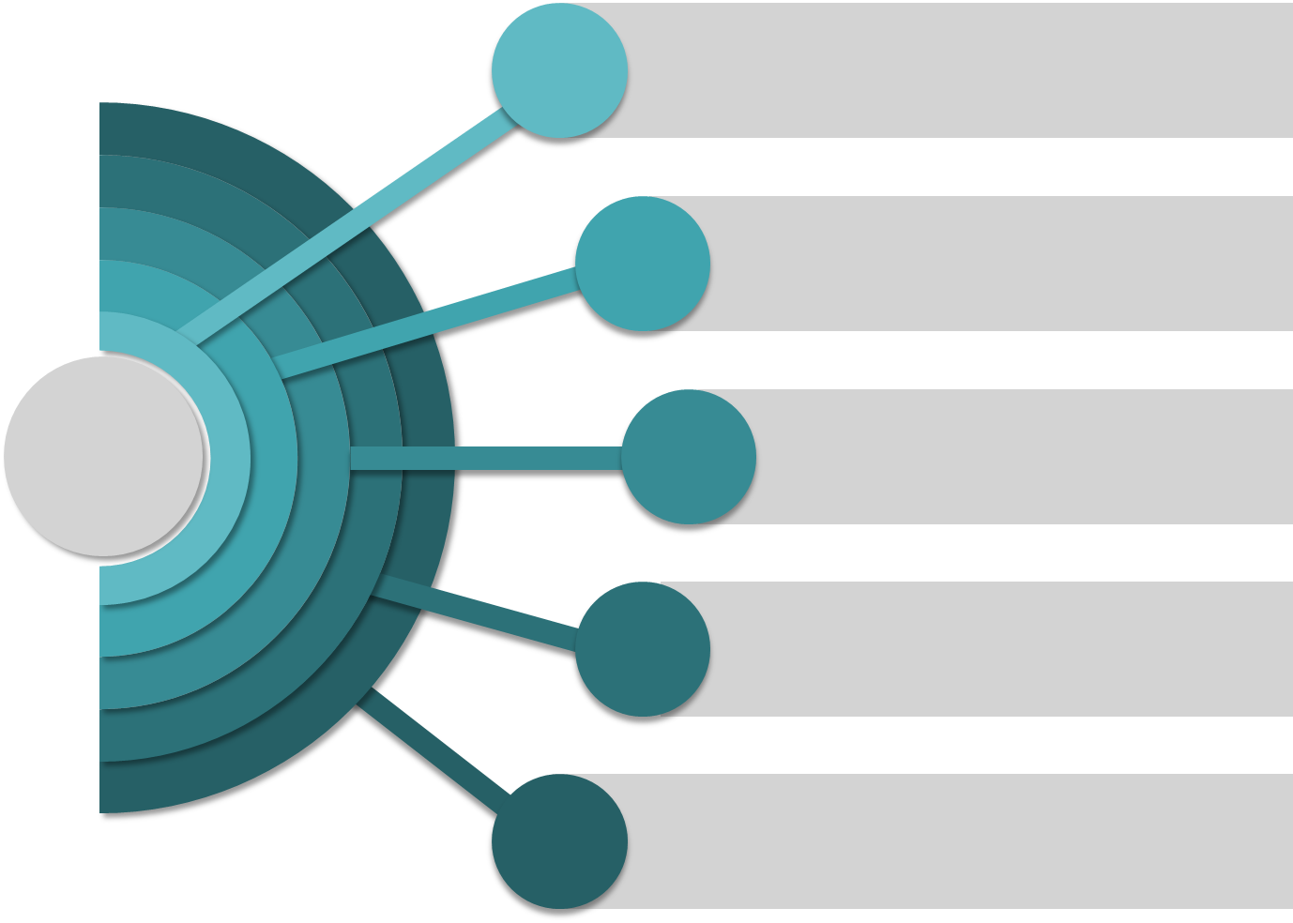
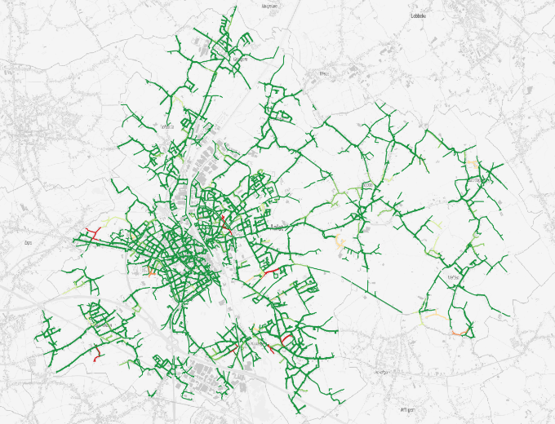
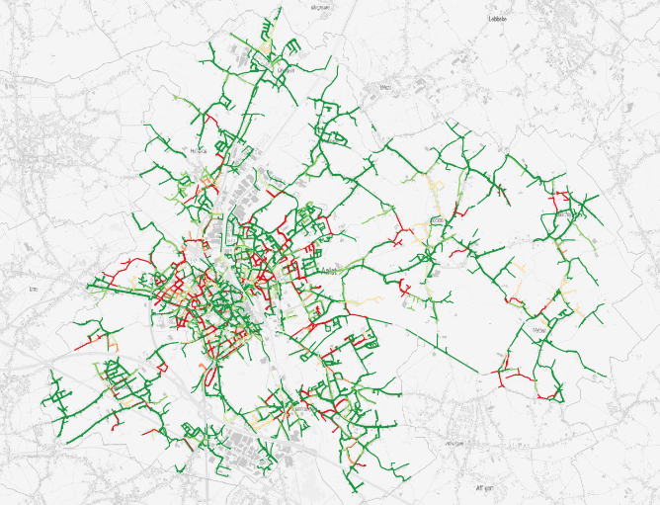

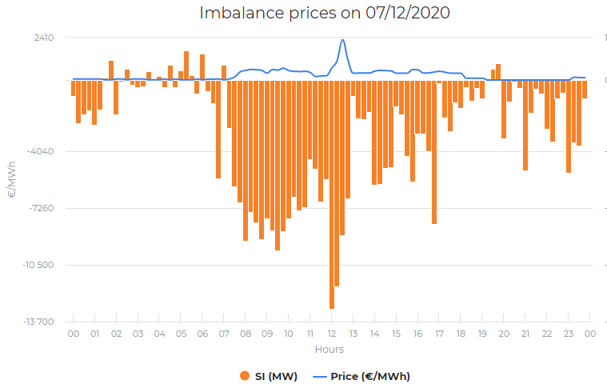
From an energy landscape in transition … to collaboration
GRID CONSTRAINTS
0% EV
50% EV, 3x16A
DIGITALISATIon
DECENTRALISATIon
COLLECTIVE ENERGY ACTIVITIES
DECARBONISATIon
ENERGY BALANCING
DEREGUlation
7/12/2020 - 12:30
•SI (MW) -562,86
•P (€/MWh) 2 291.01
DEMOCRATISation

Slide 6




Annelies Delnooz
Project Manager E-market
Energy Technology
EnergyVille | Thor Park 8310 | 3600 Genk
VITO NV | Boeretang 200 | 2400 Mol tel. +32 14 33 59 62
Annelies.delnooz@vito.be |
Annelies.delnooz@energyville.be

